Slide 1
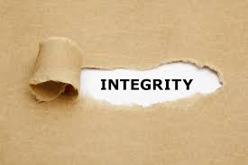
A poem by Gary Dodd

Slide 2
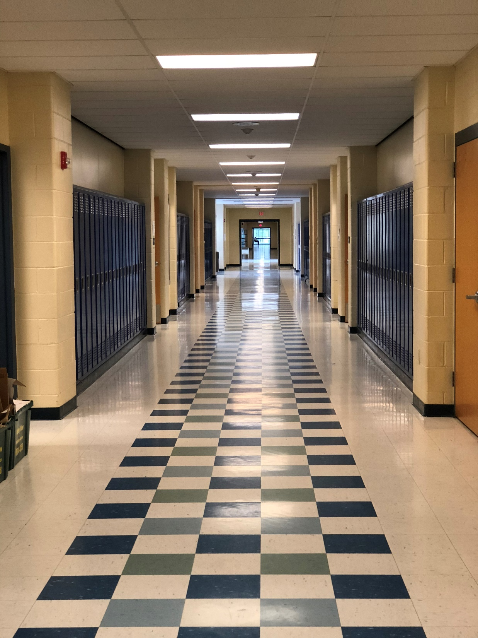

Slide 3
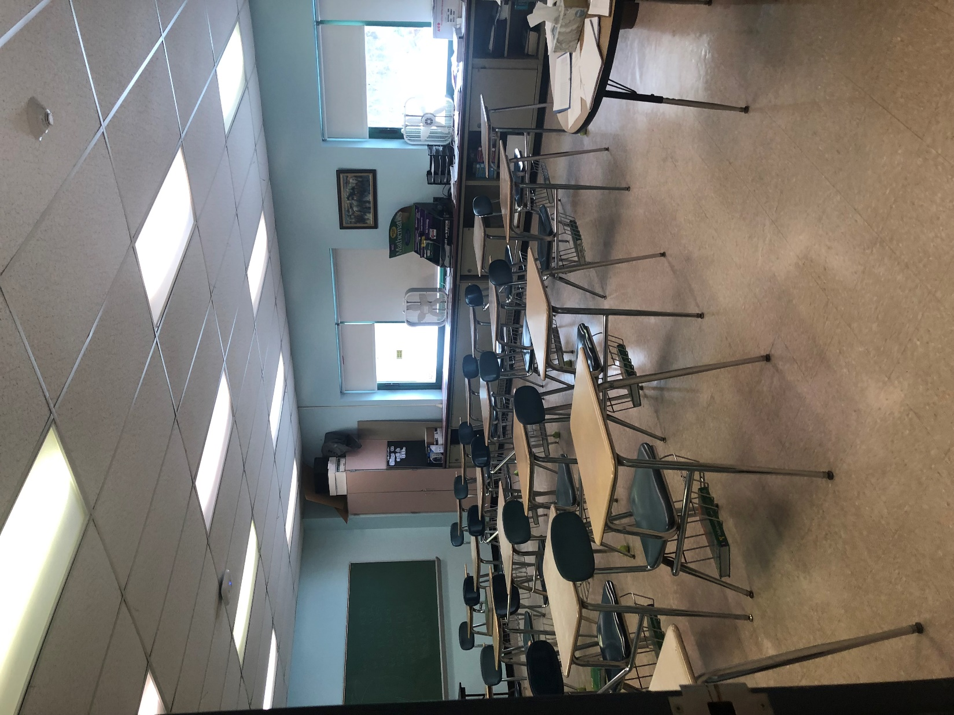

Slide 4
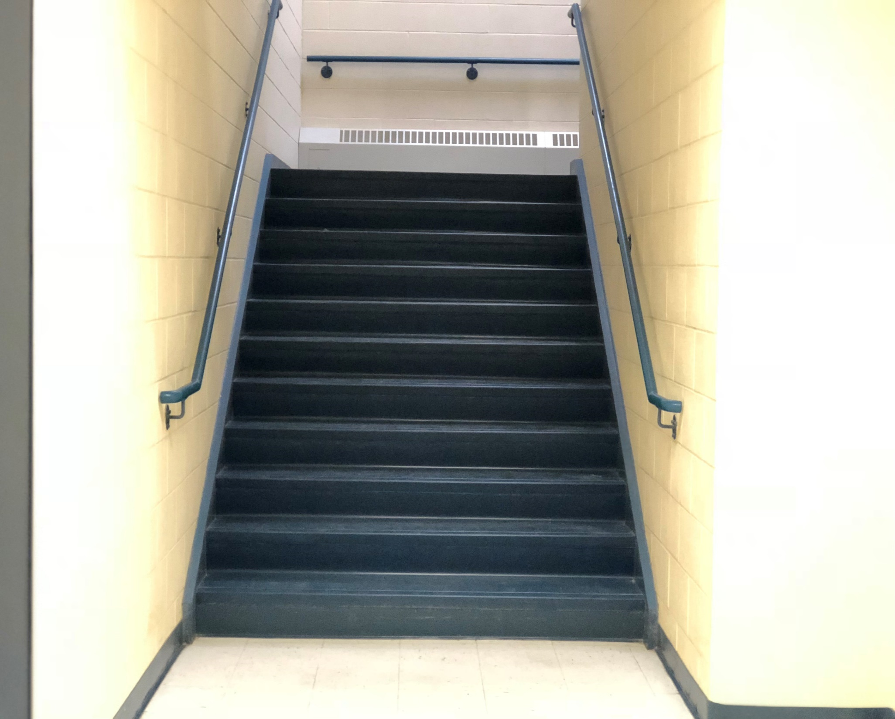

Slide 5
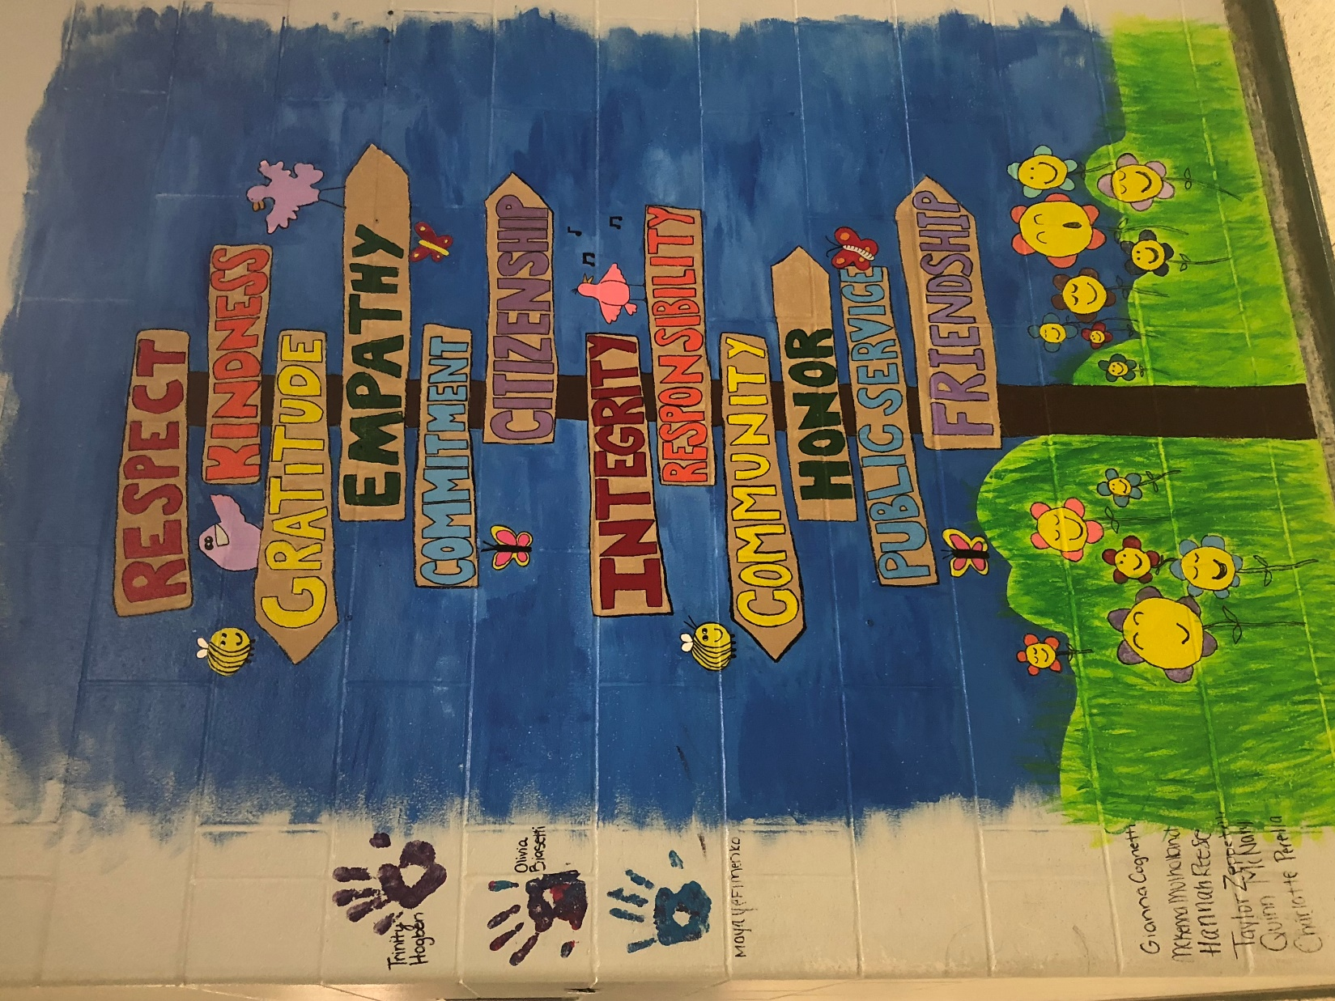

Slide 6
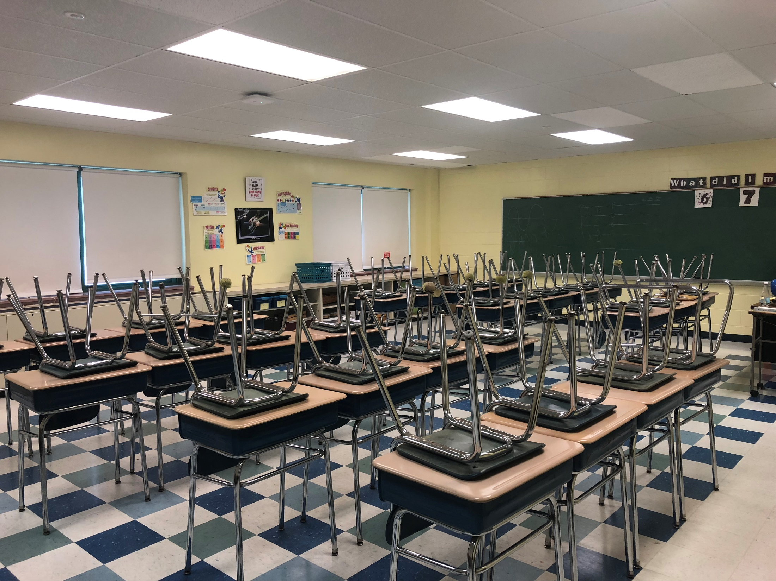

Slide 7
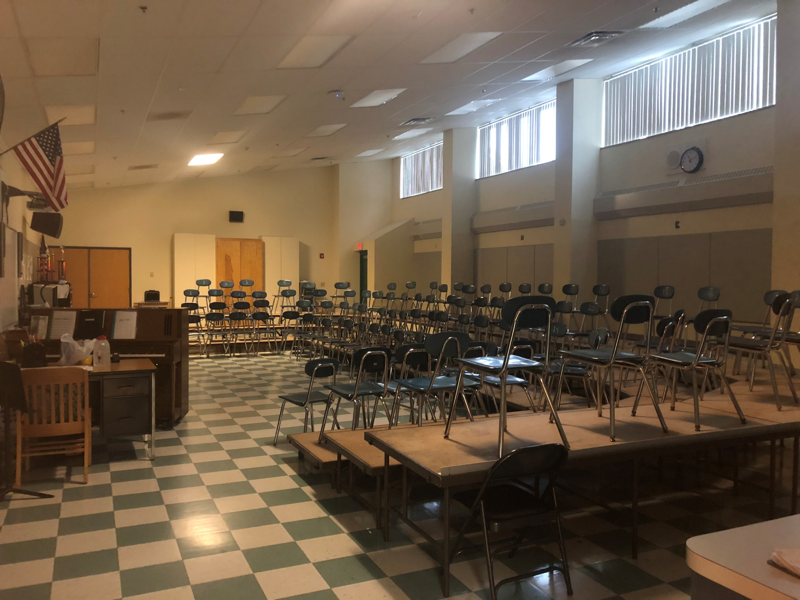

Slide 8
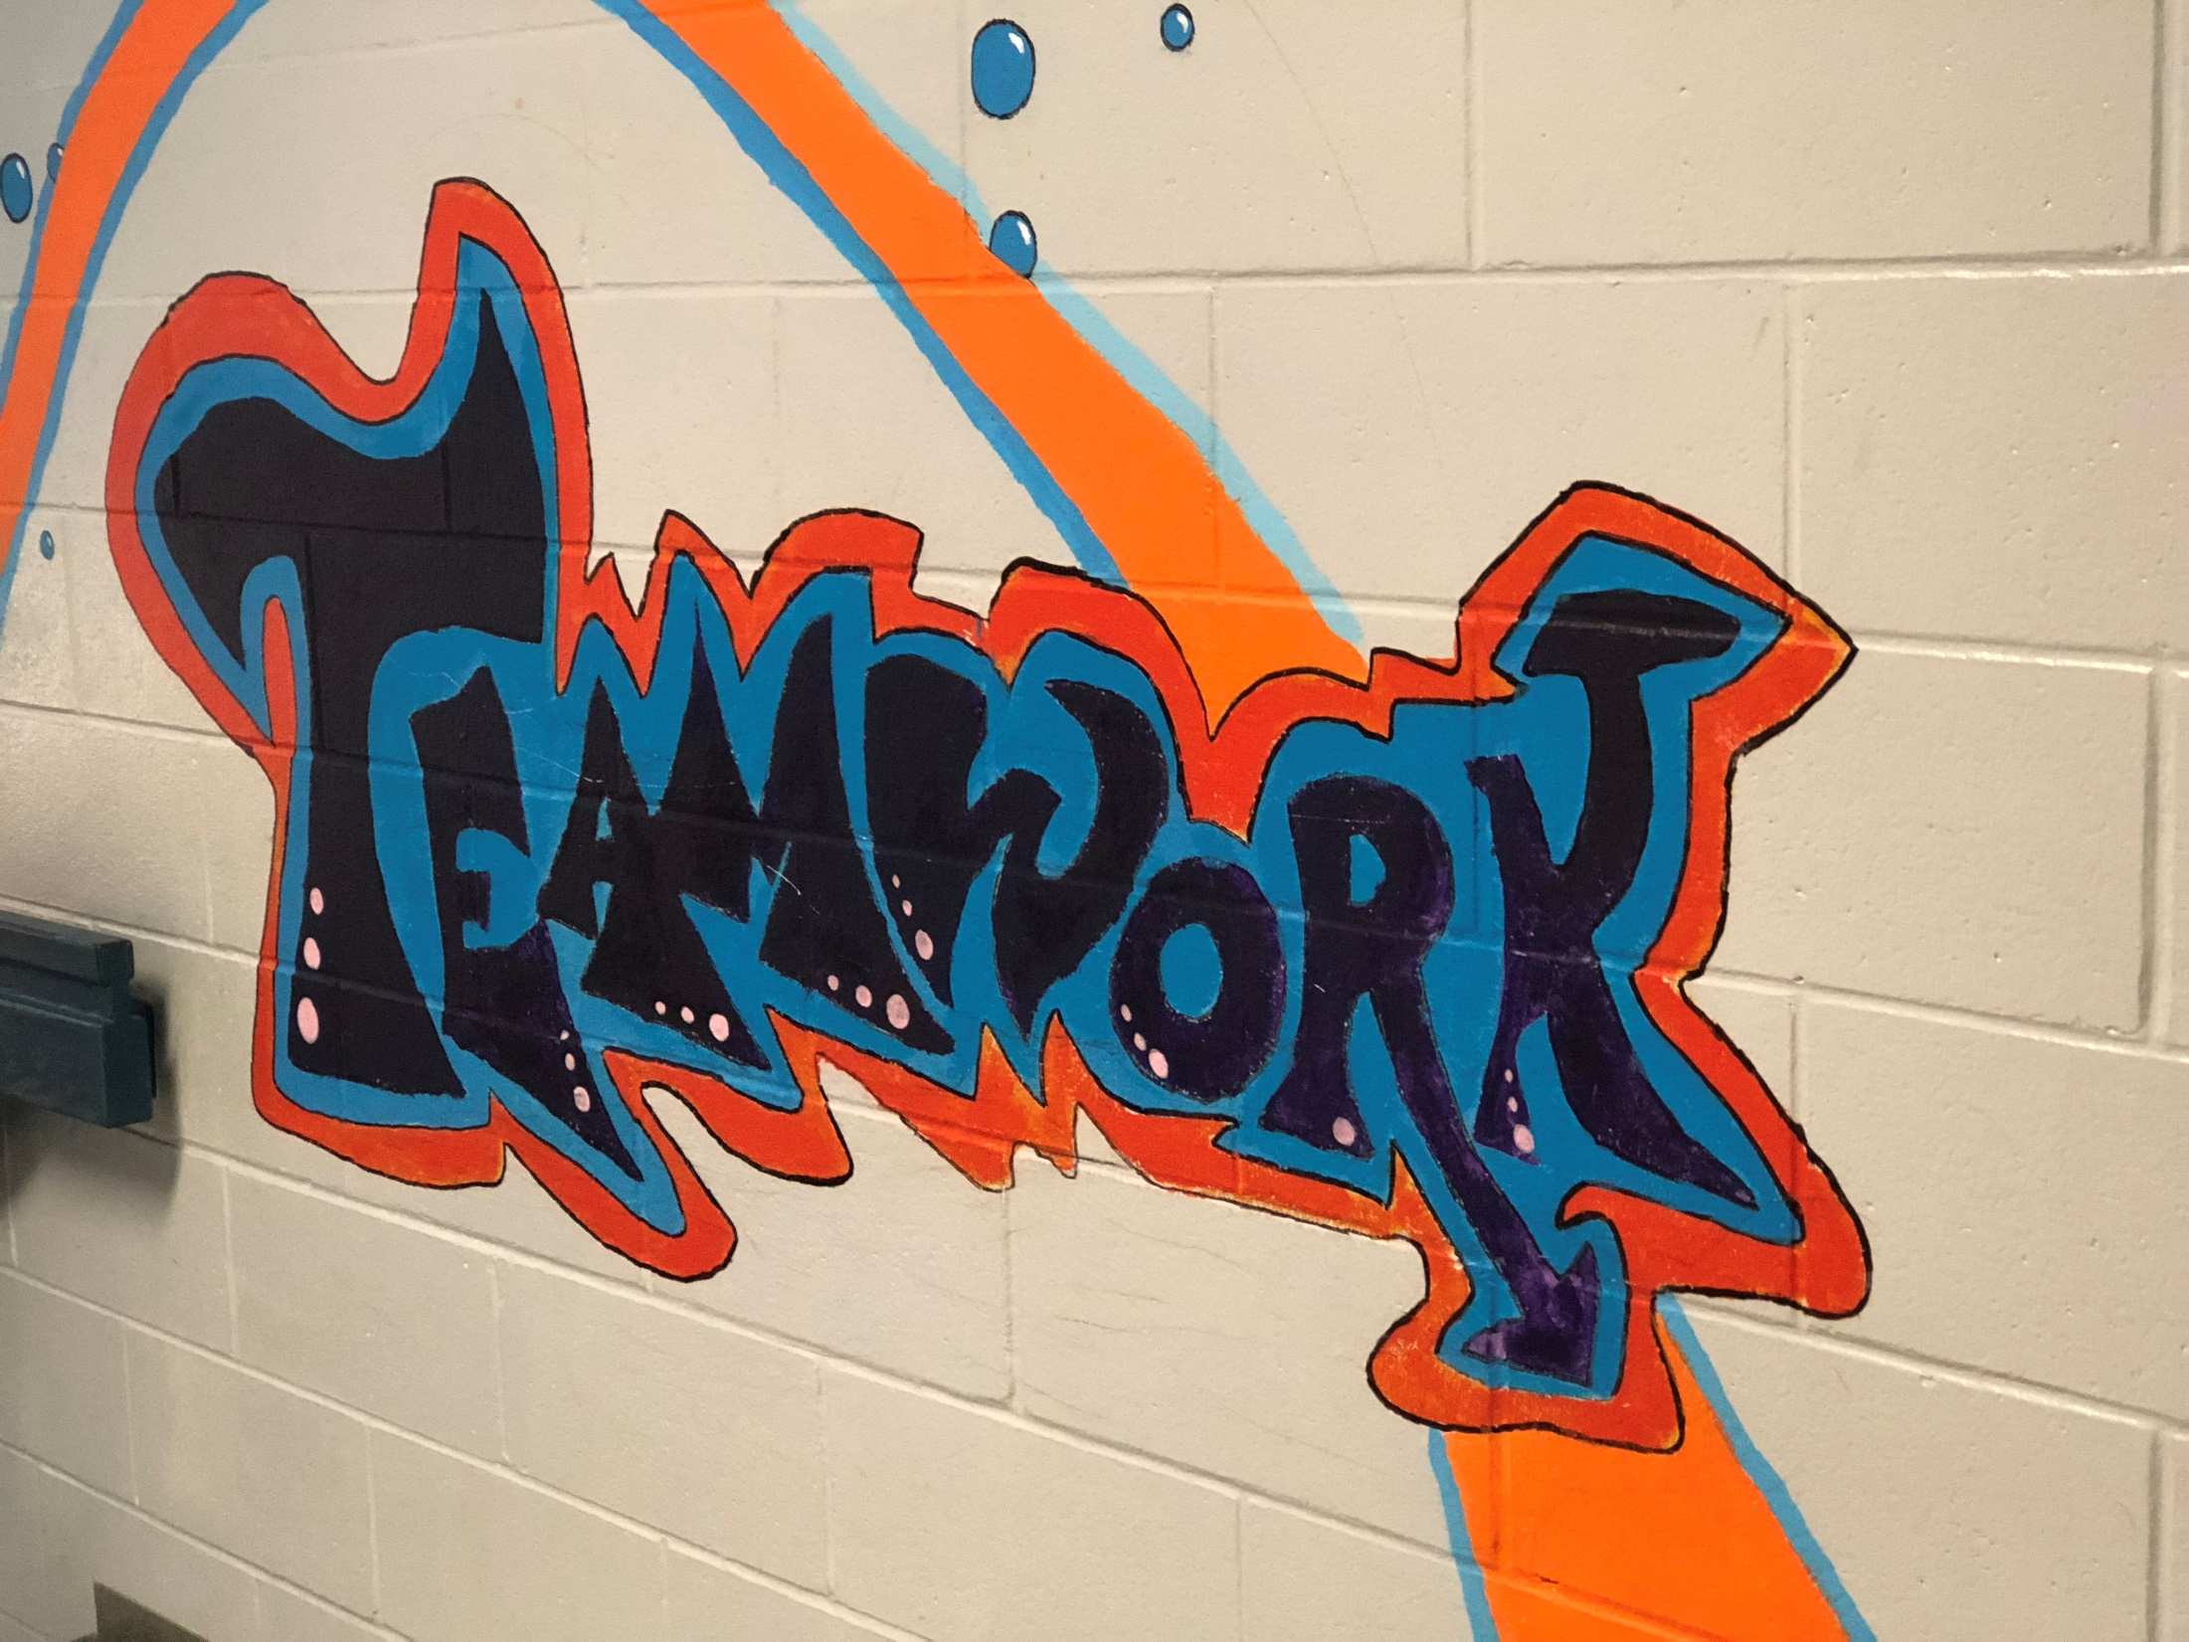

Slide 9
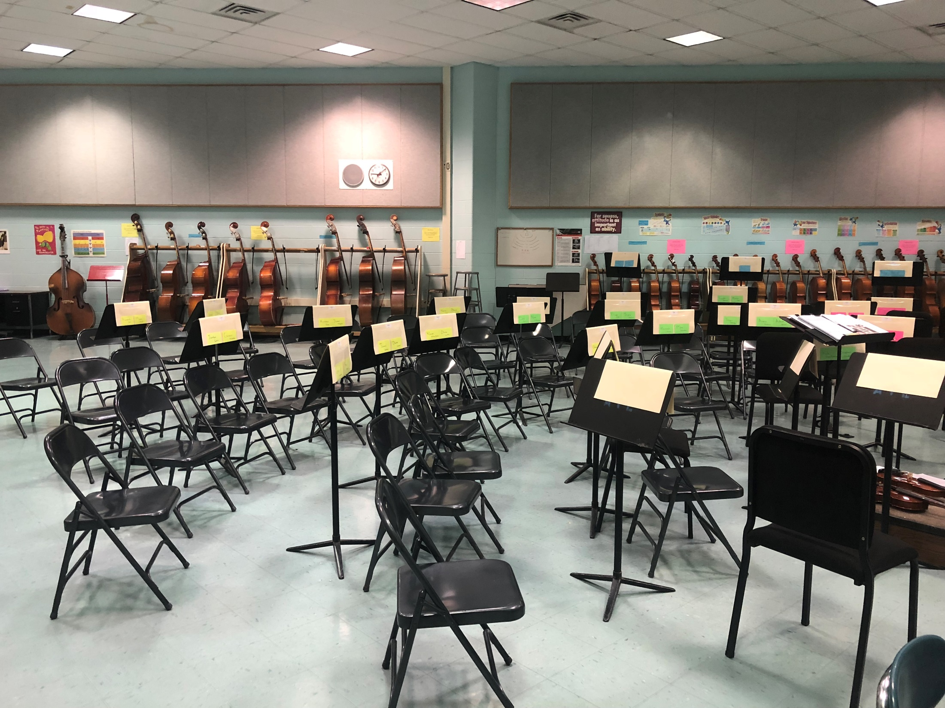

Slide 10
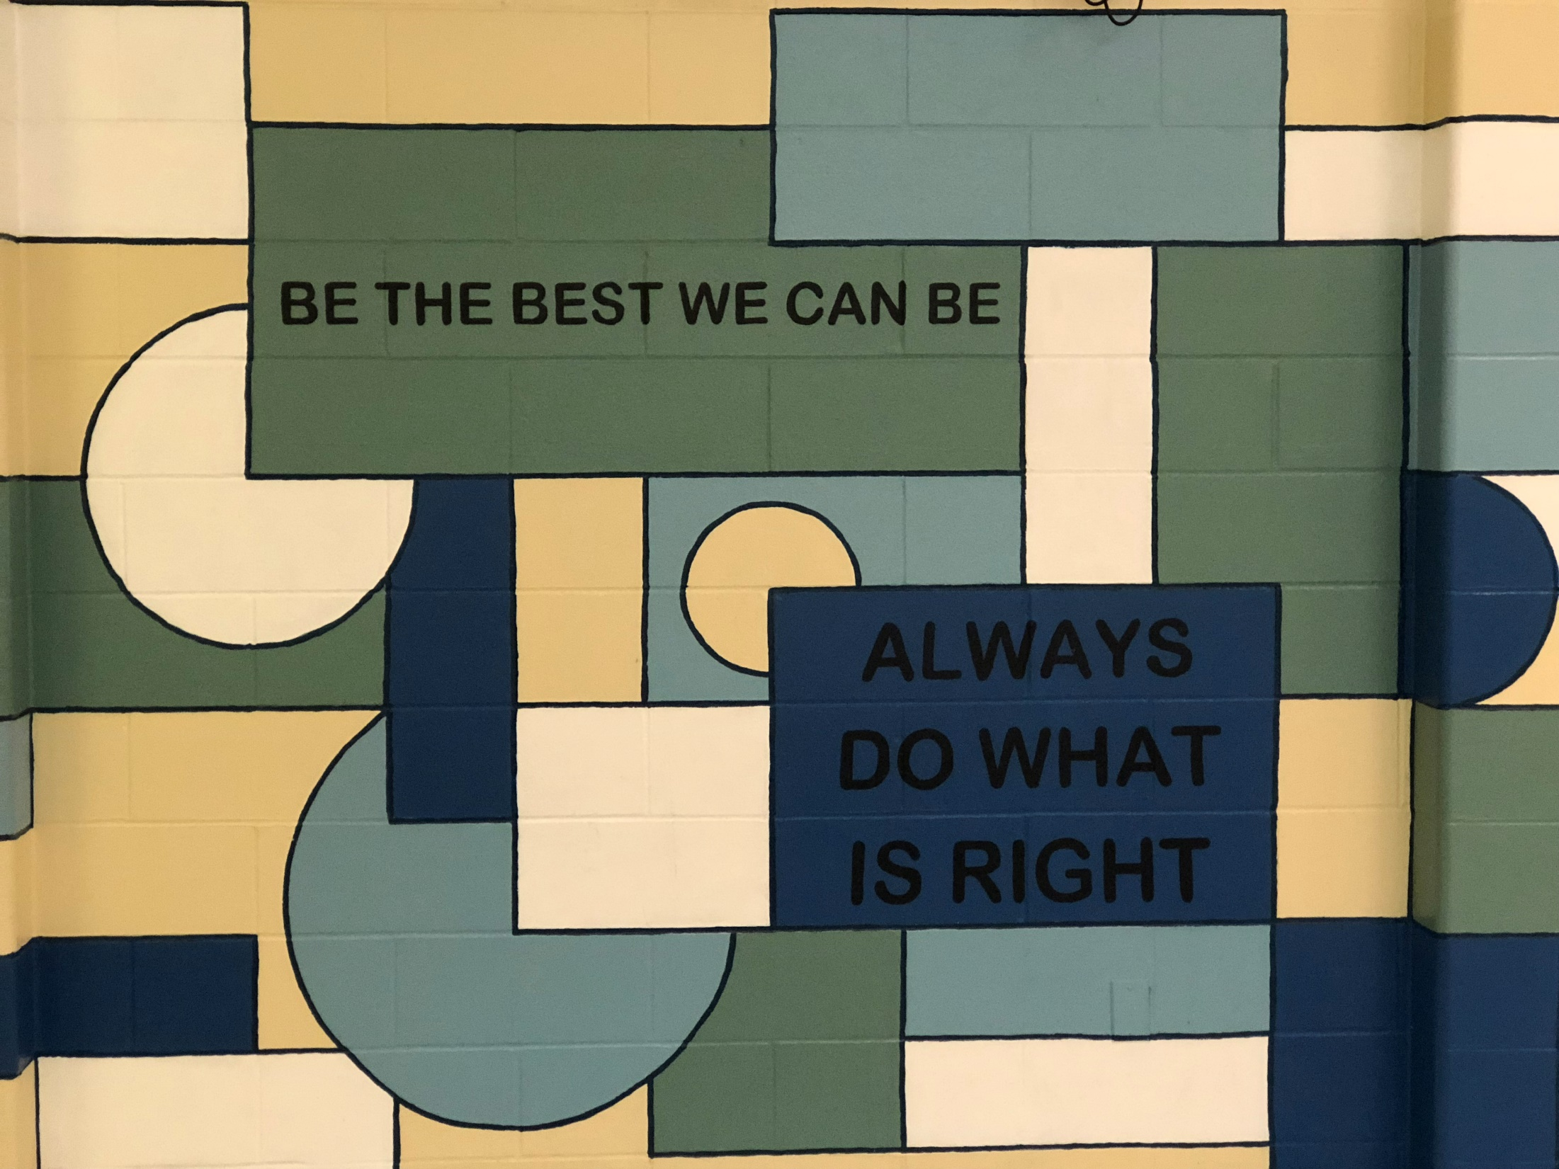

Slide 11
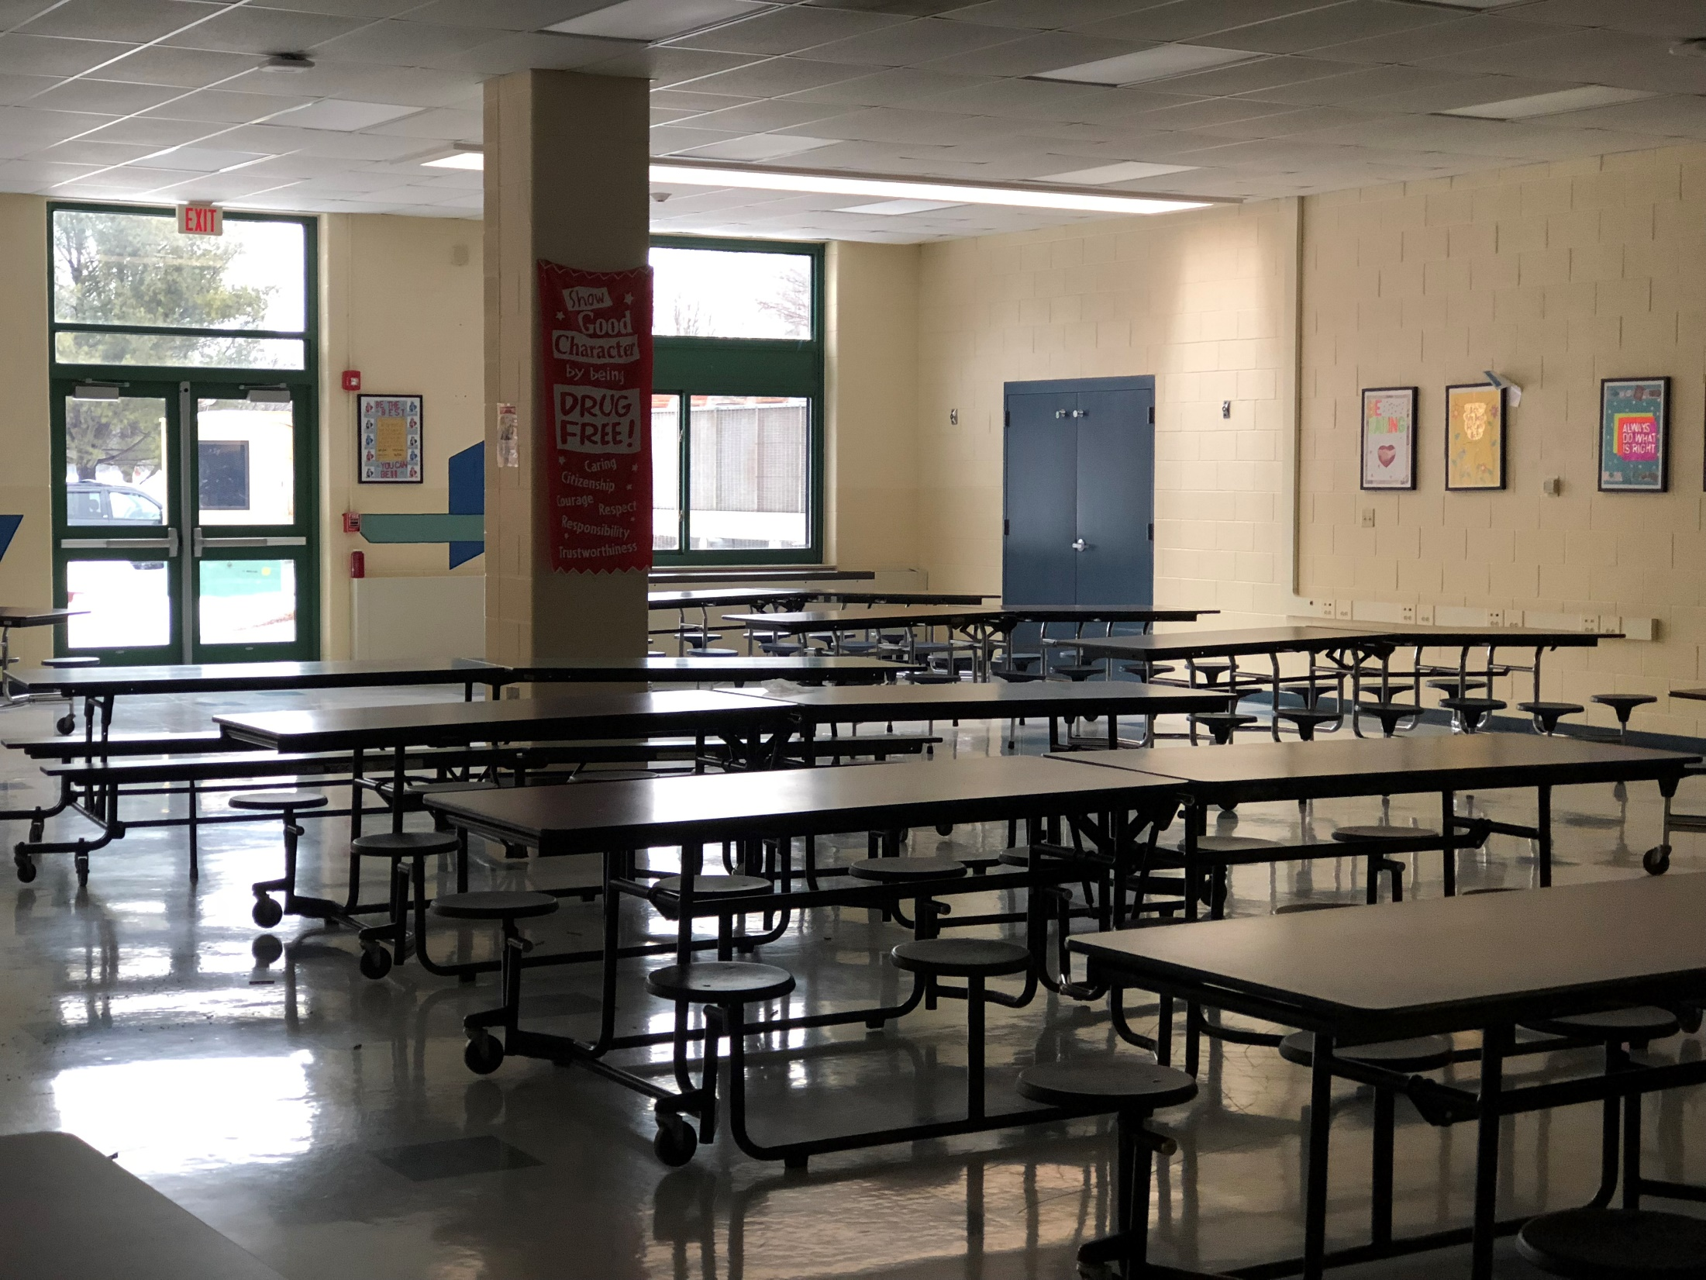

Slide 12
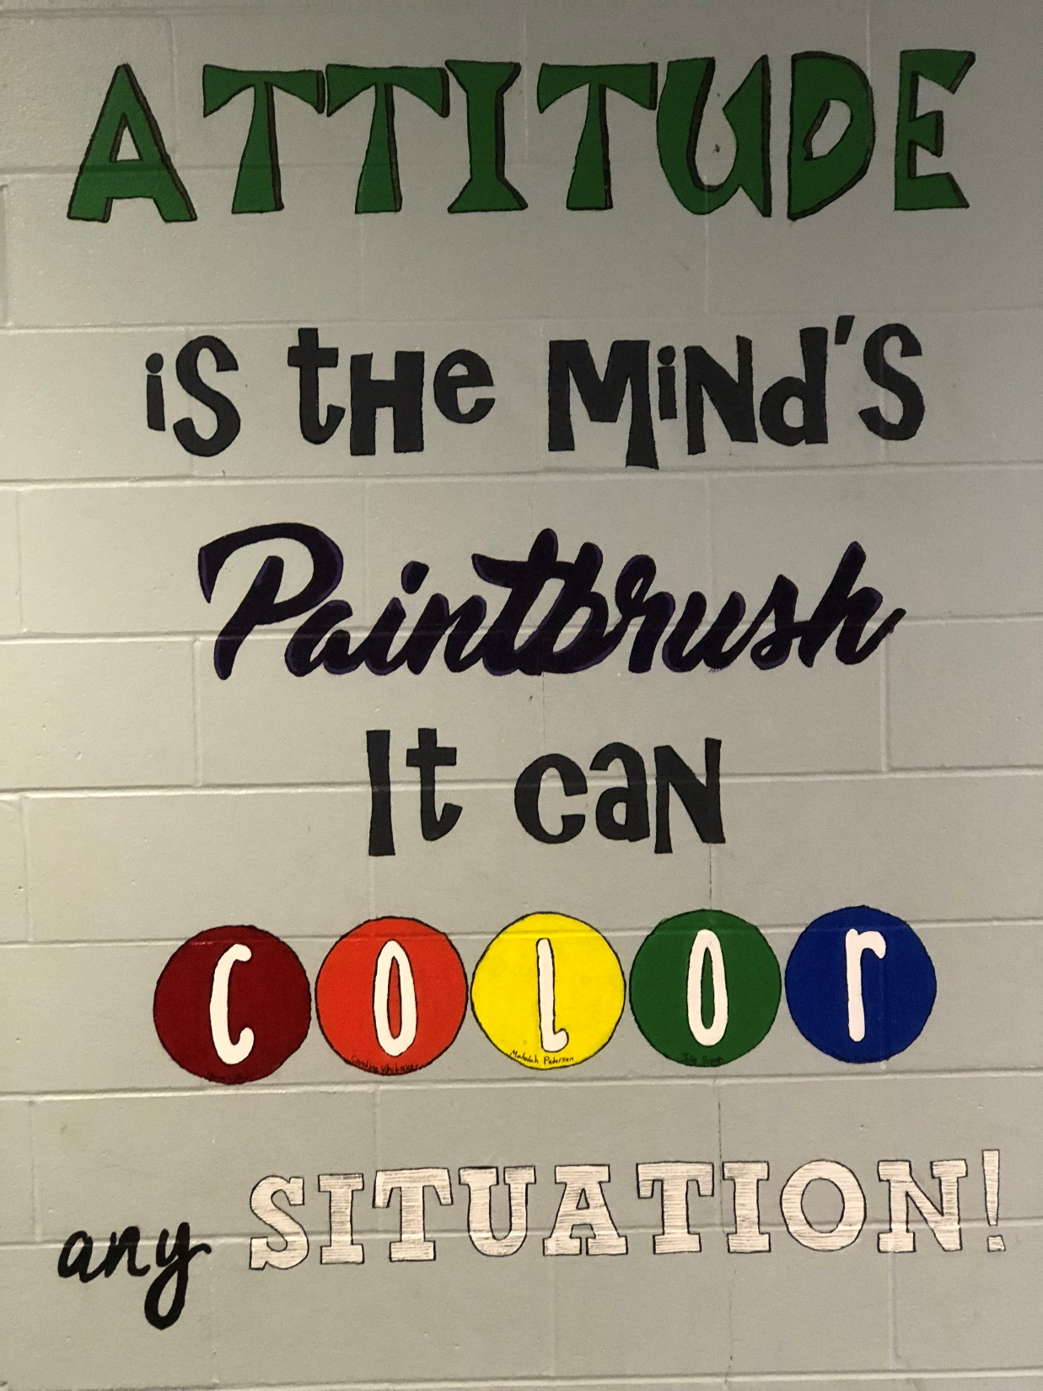

Slide 13
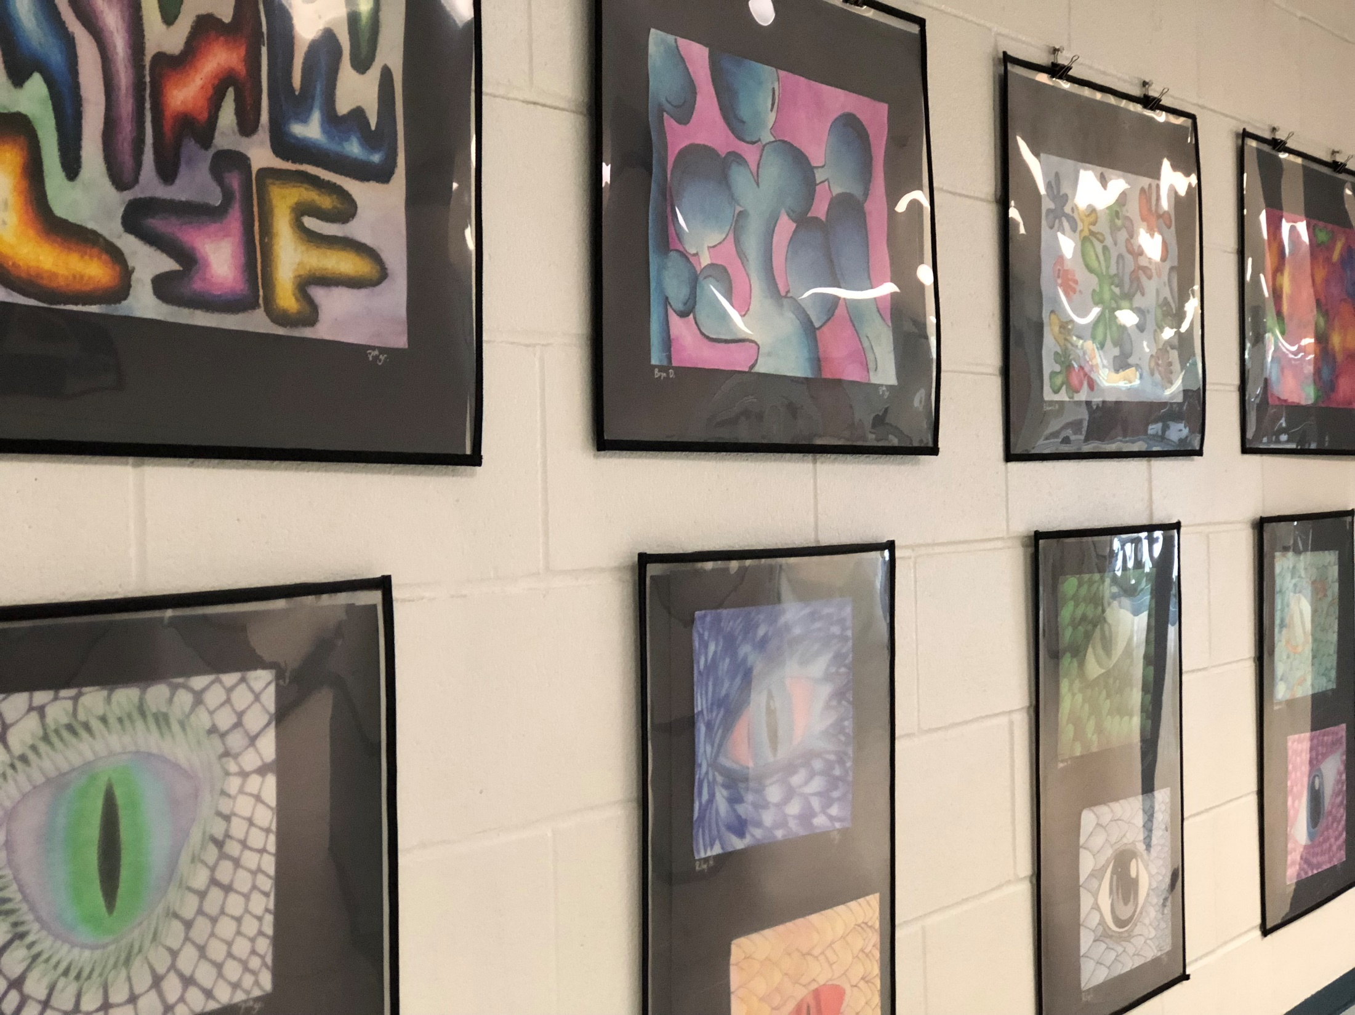

Slide 14
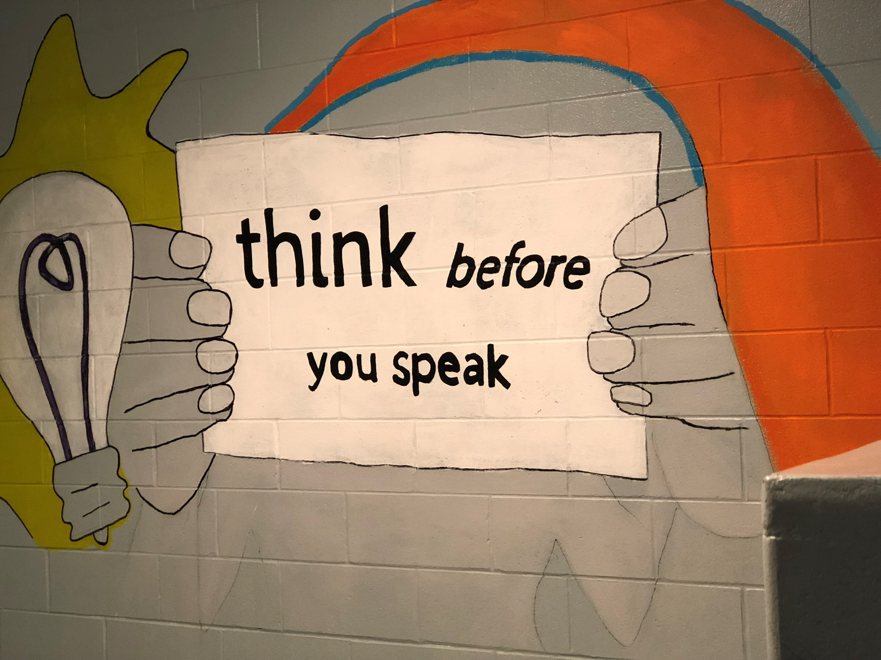

Slide 15
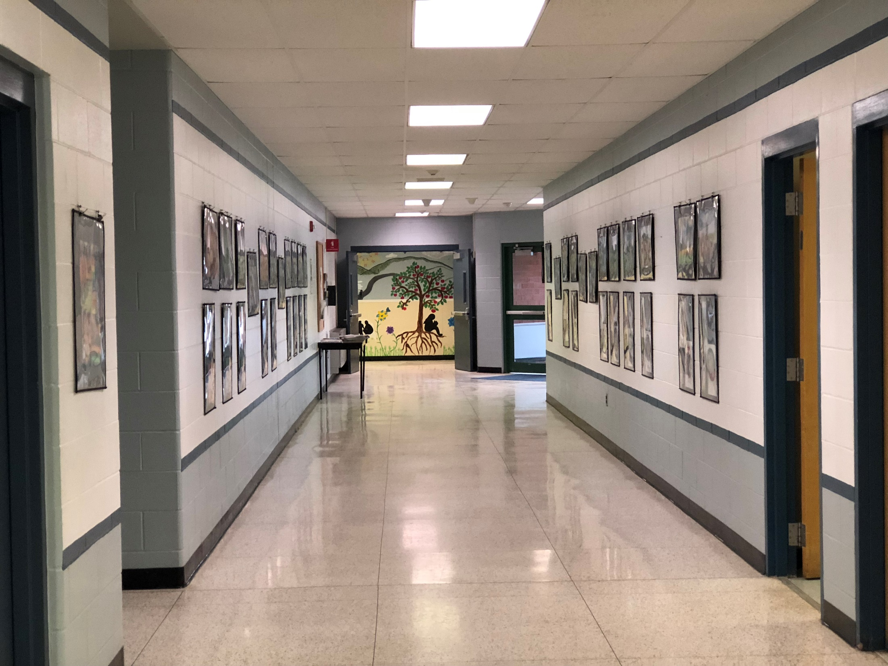

Slide 16
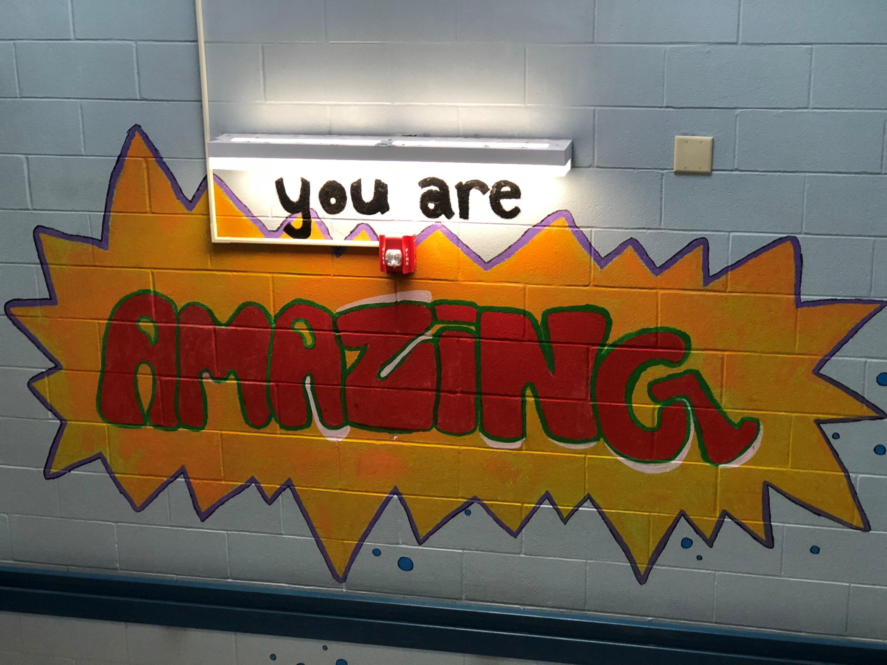

Slide 17
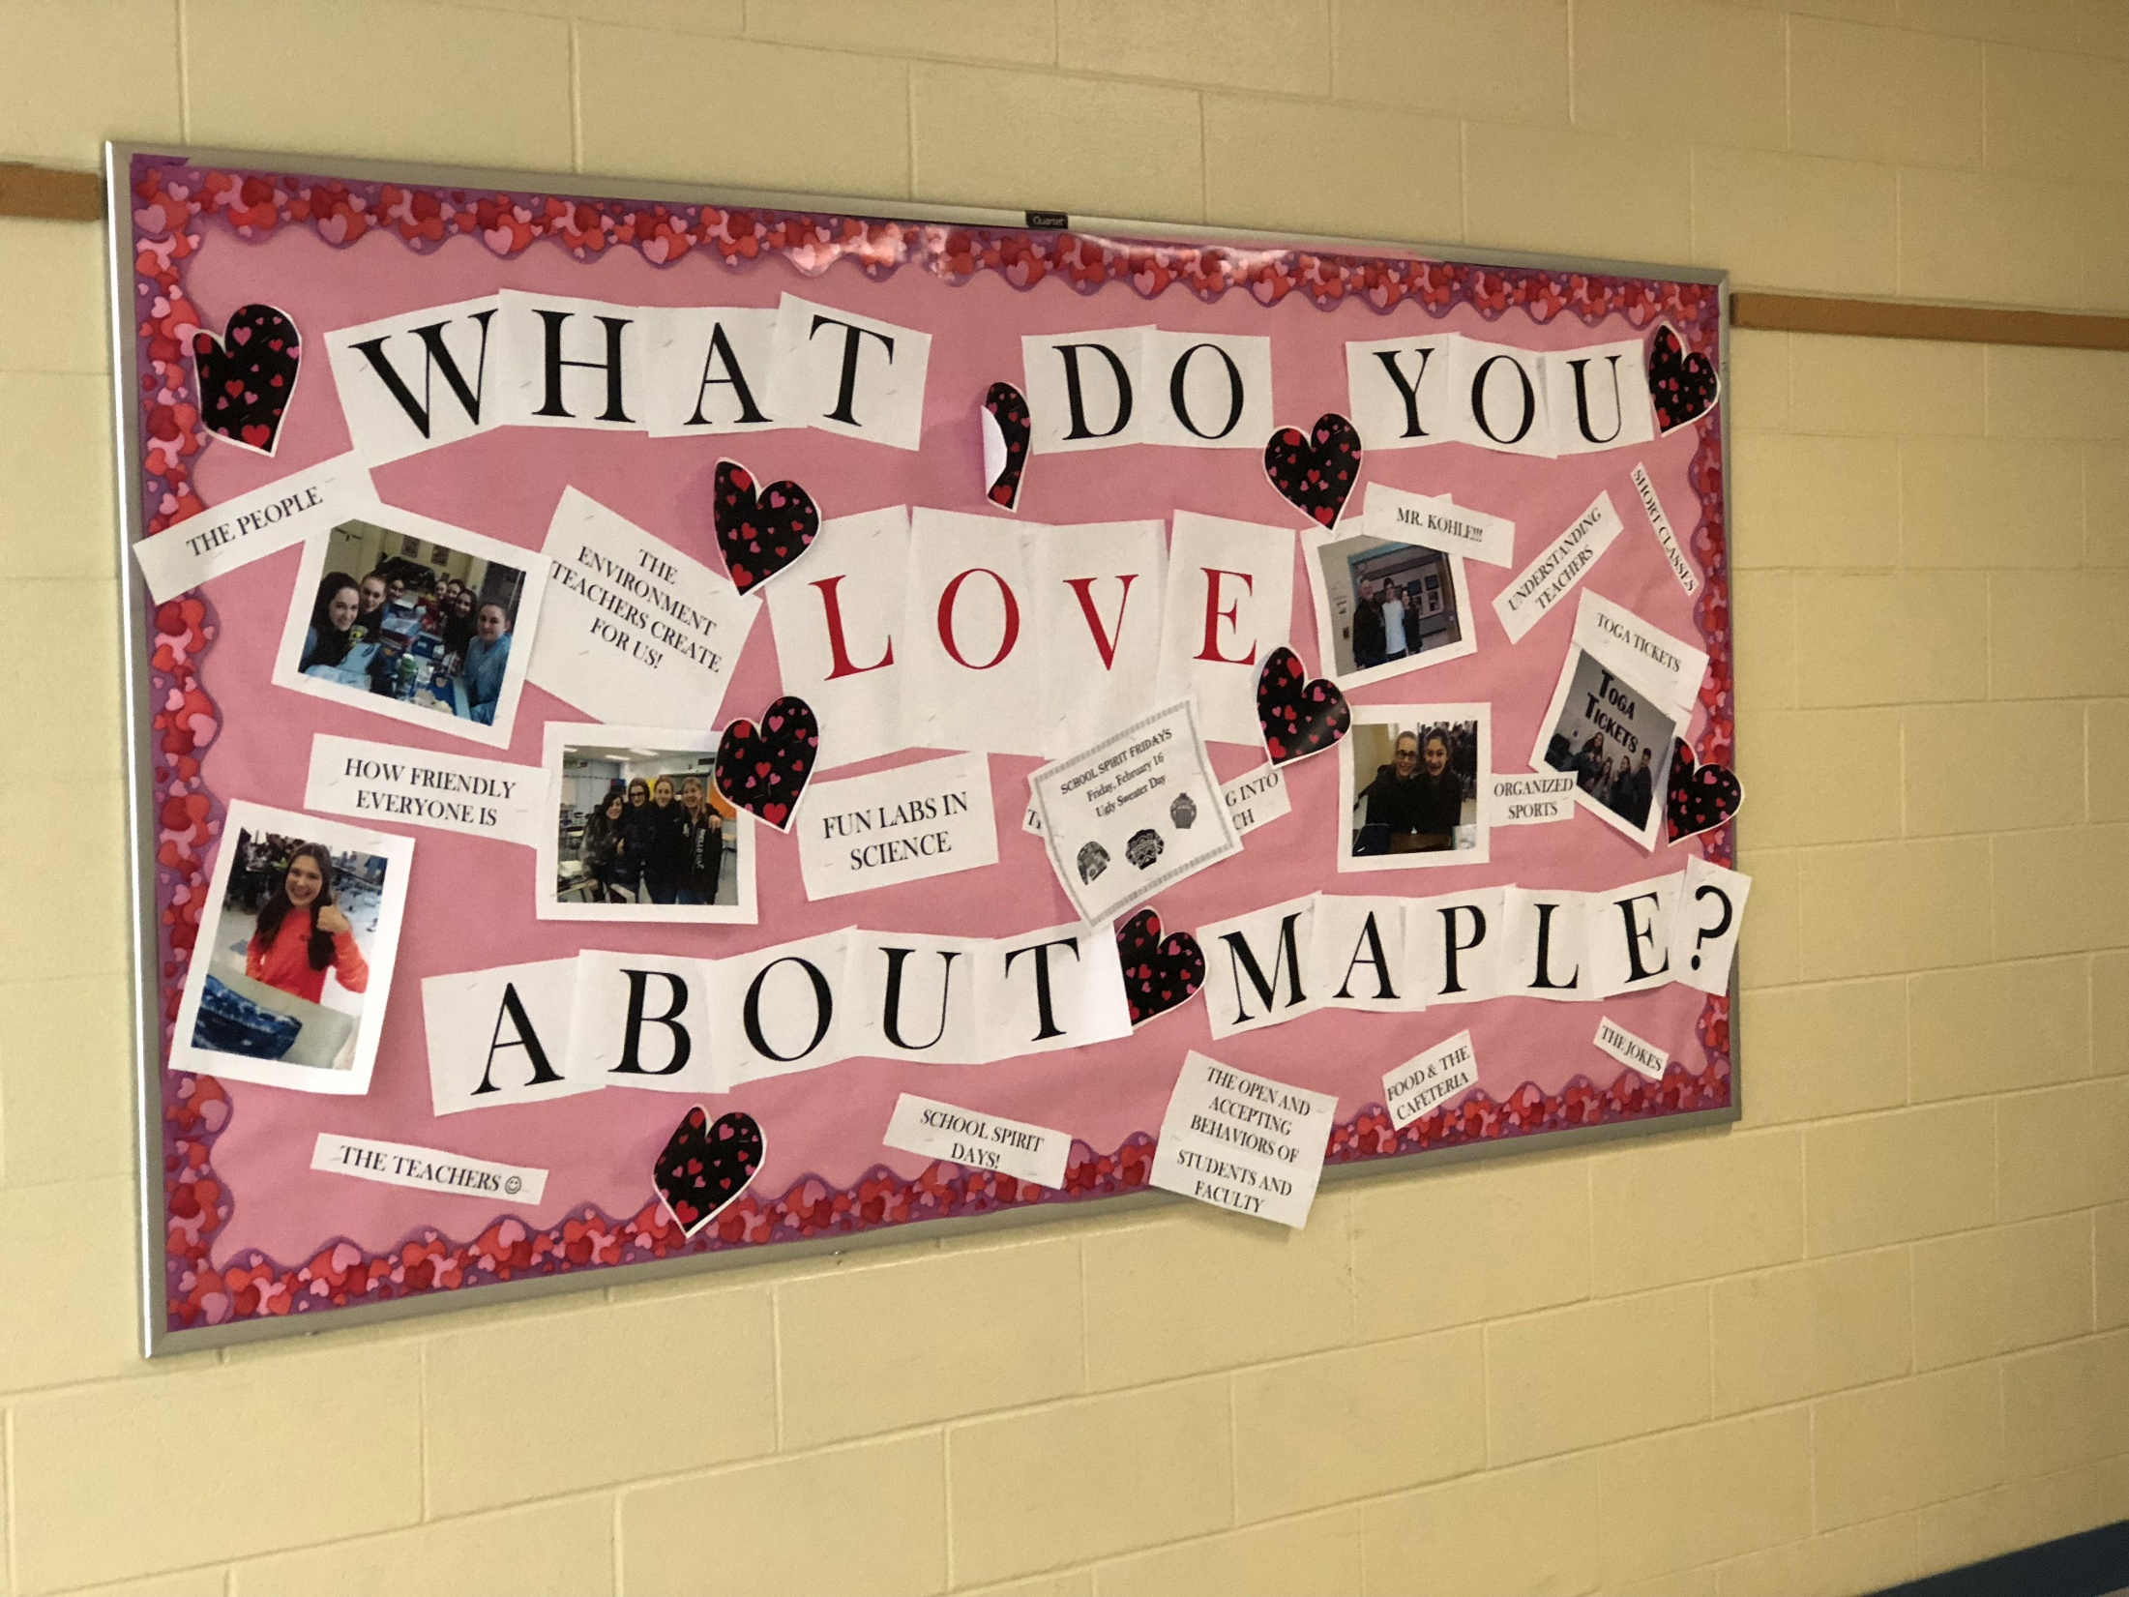

Slide 18
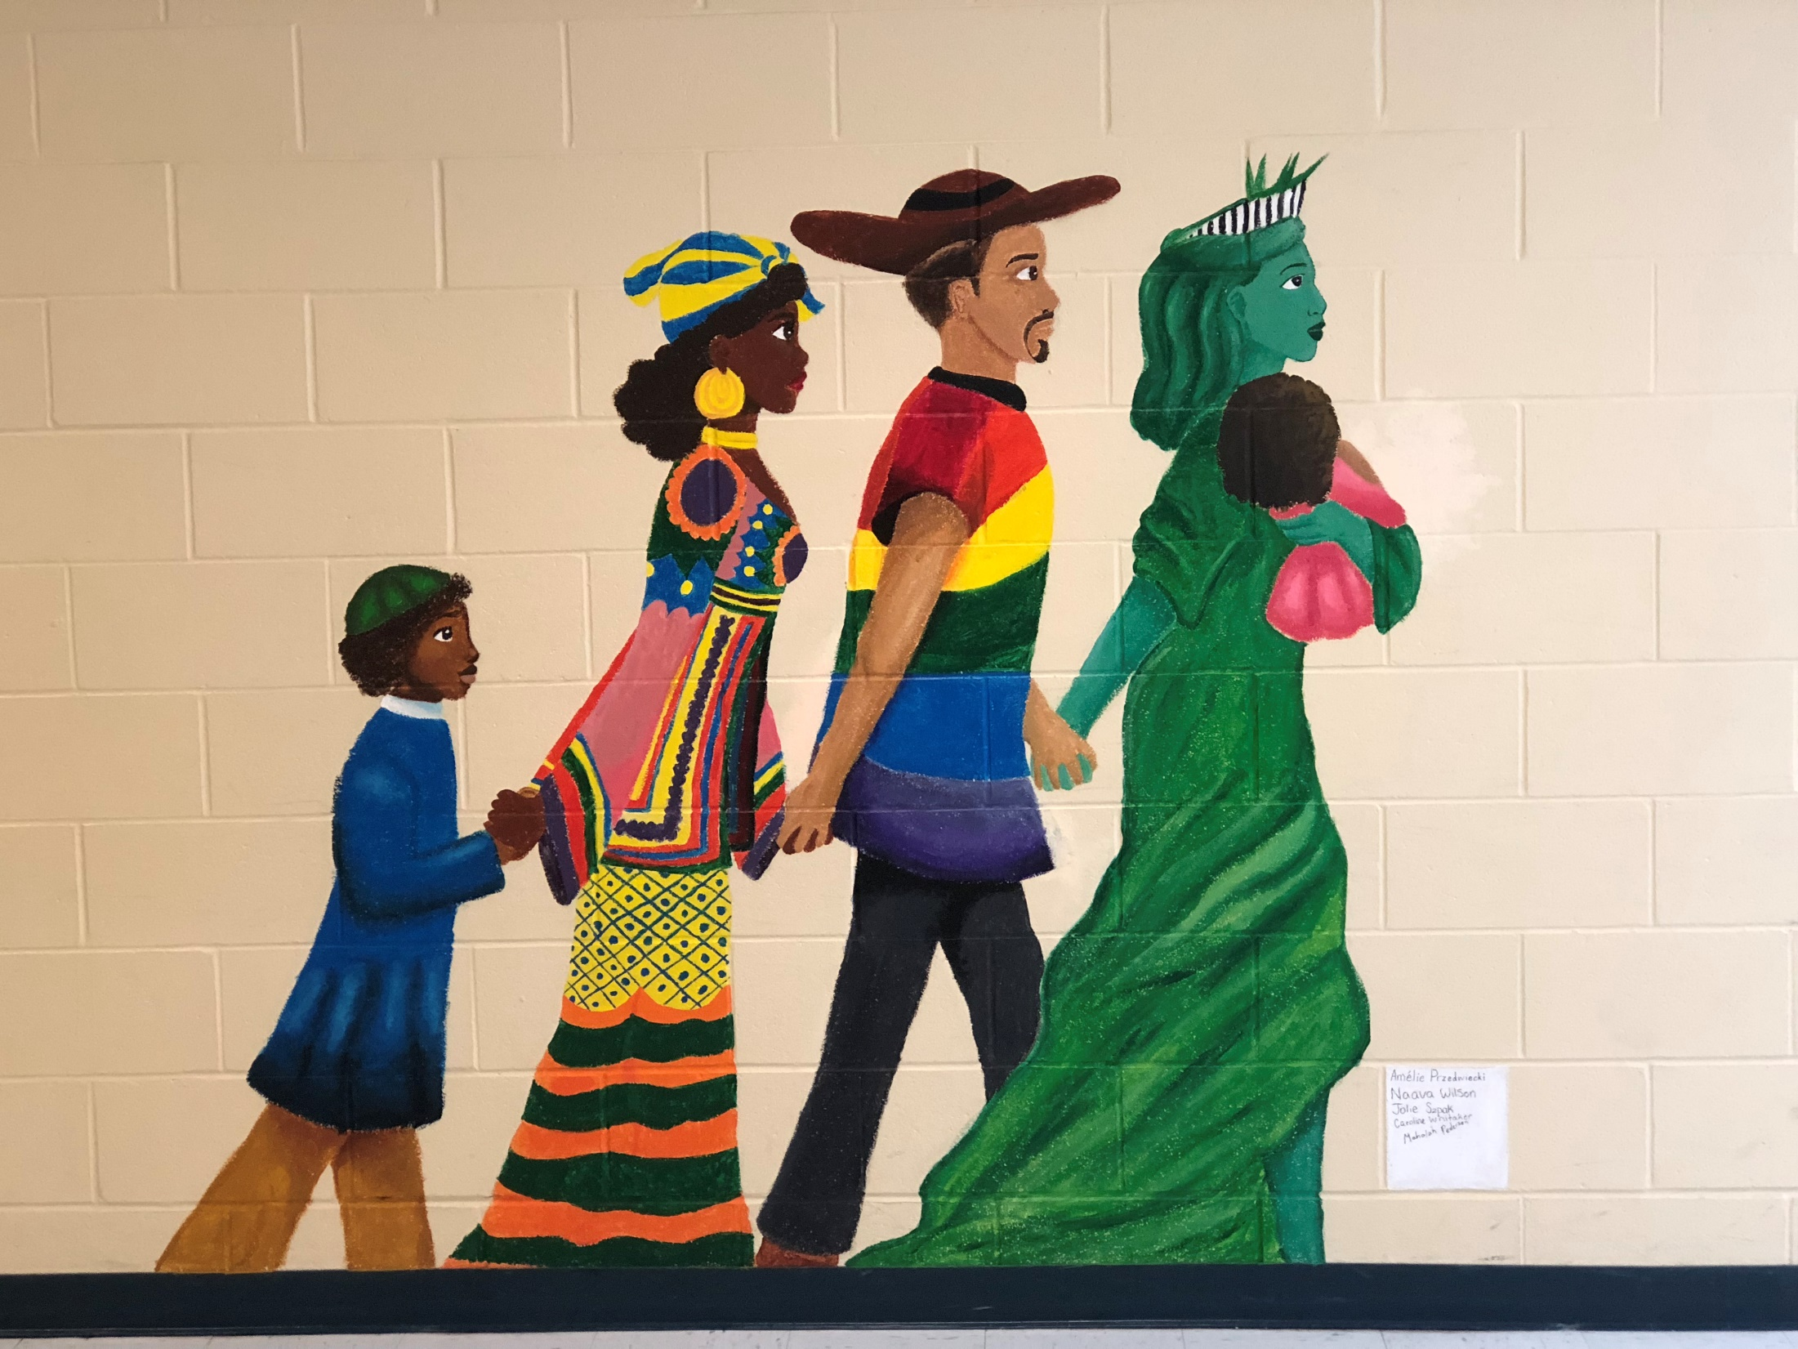

Slide 19
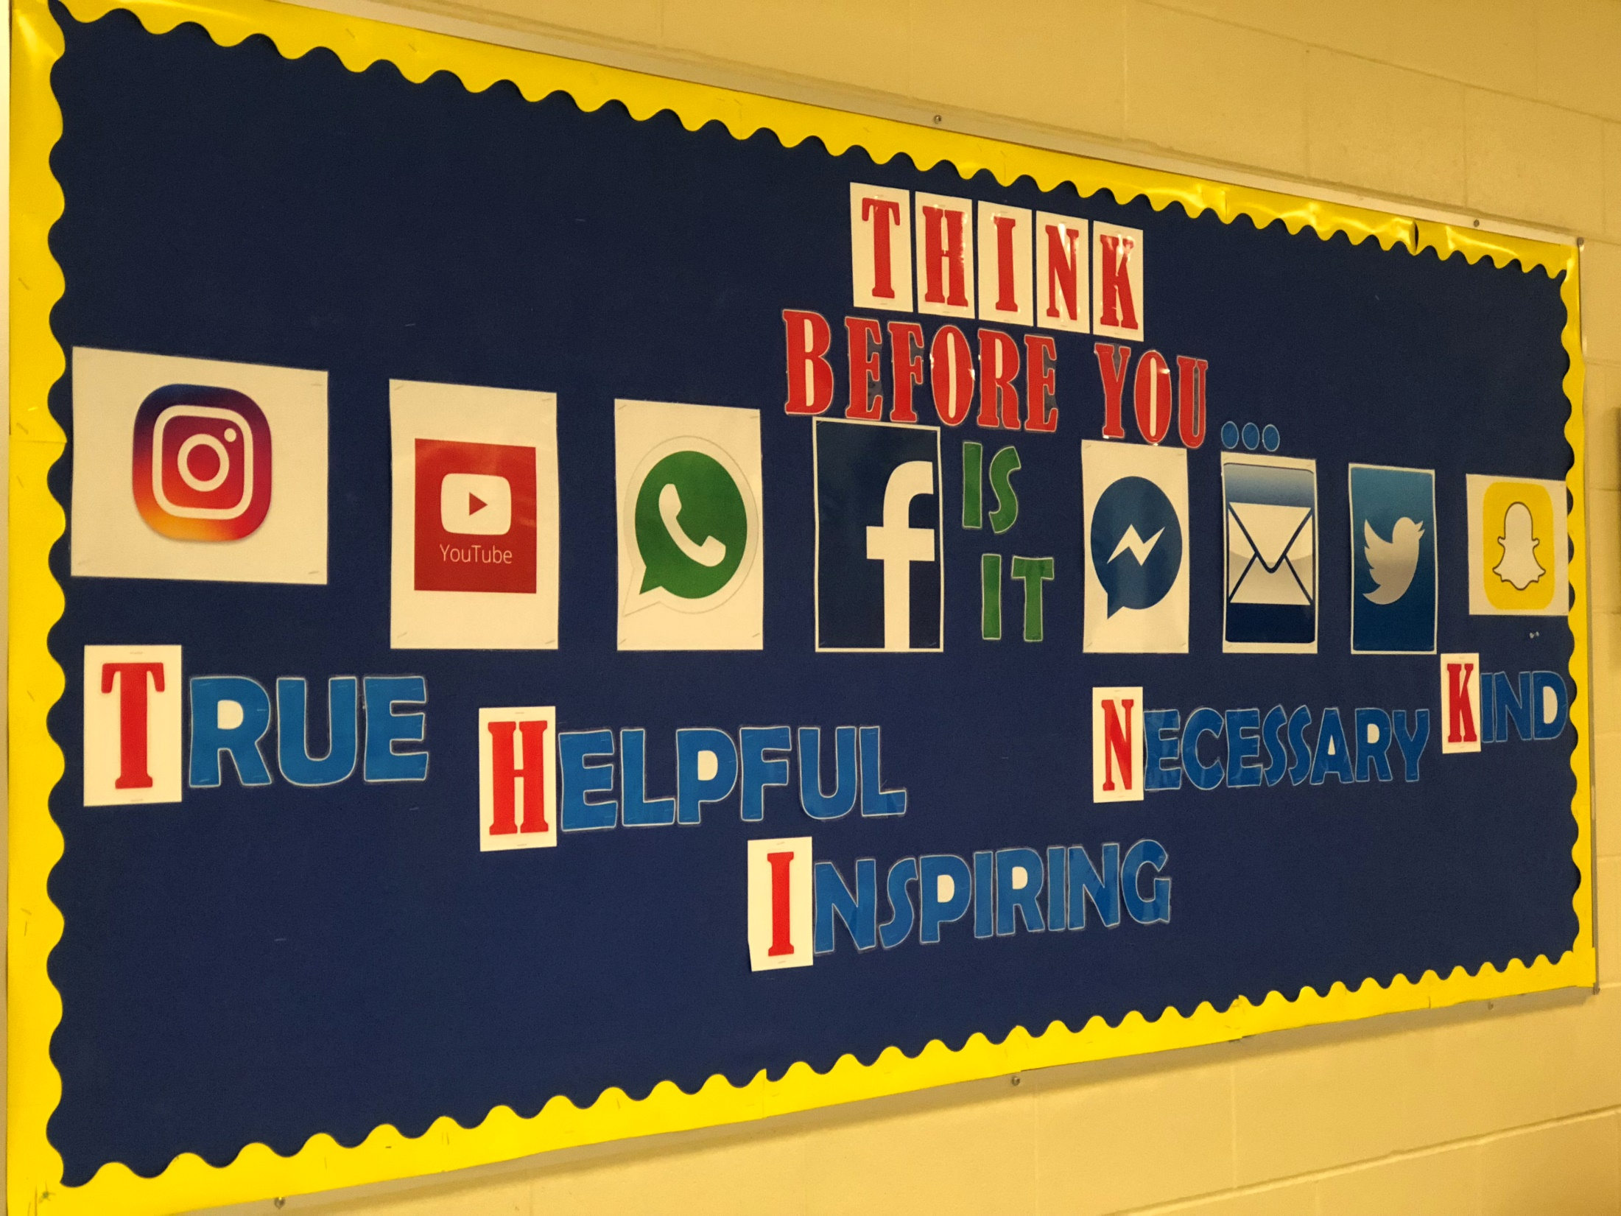

Slide 20
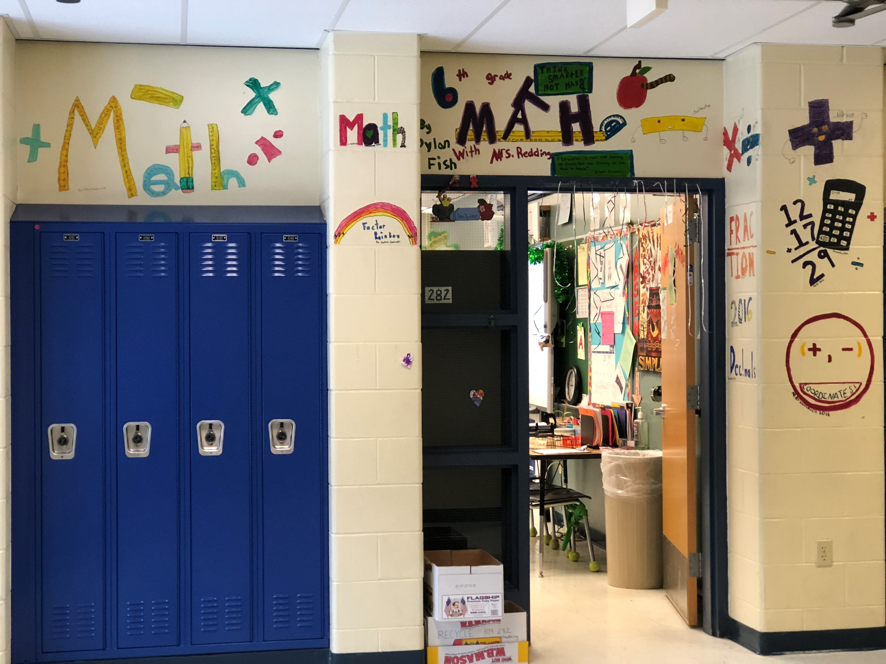

Slide 21
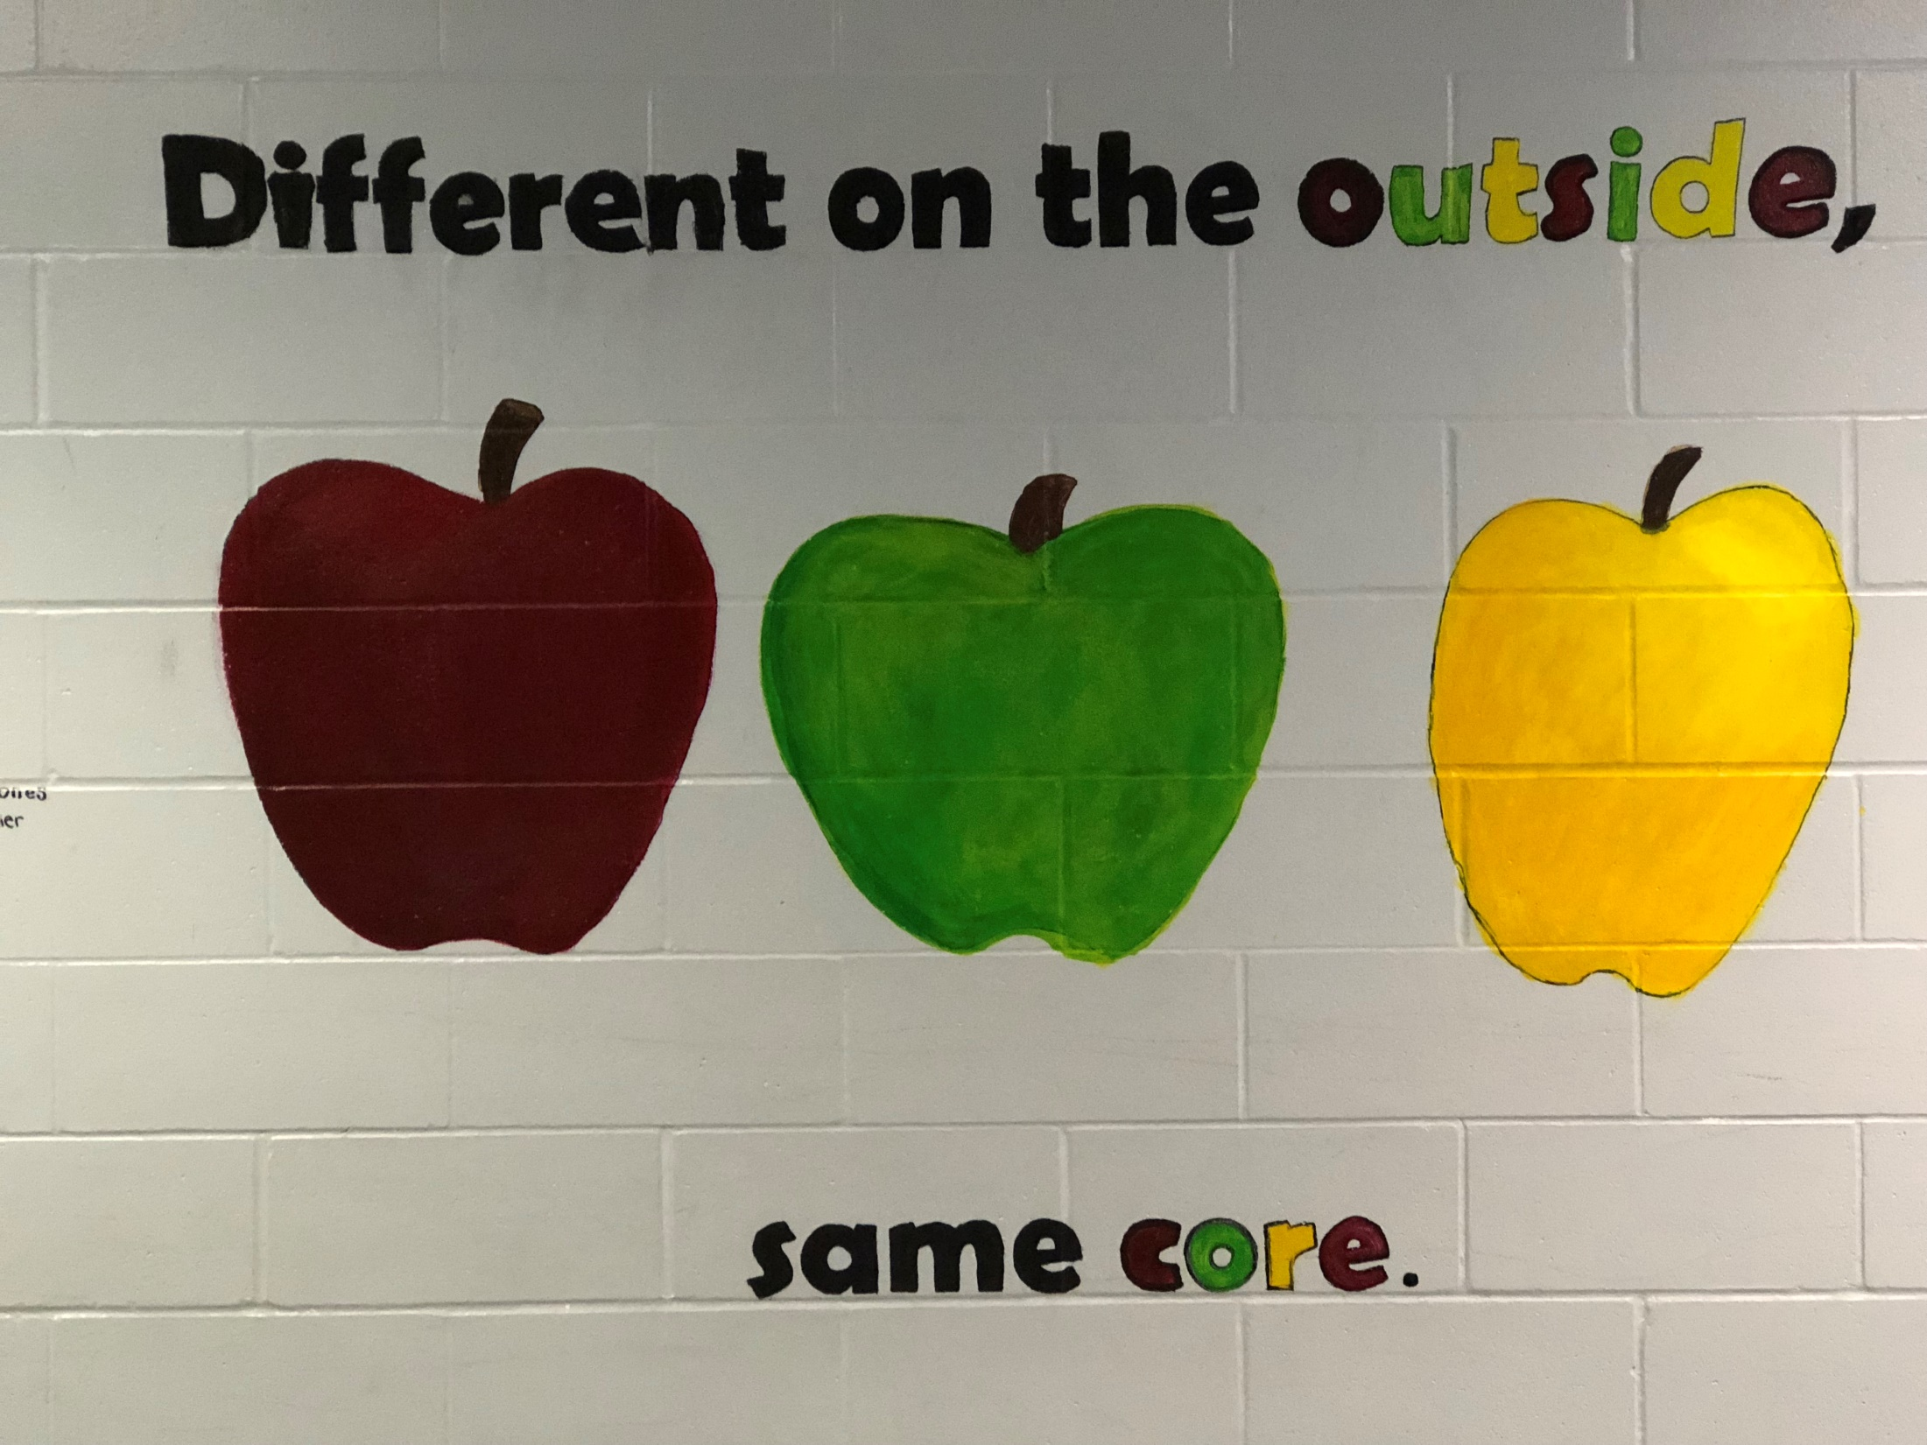

Slide 22
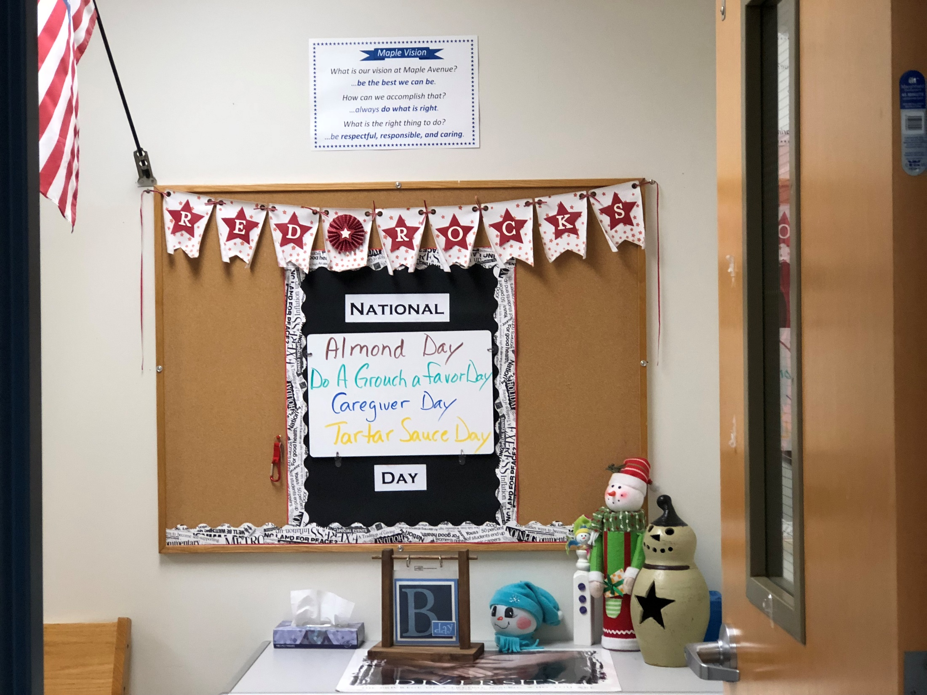

Slide 23
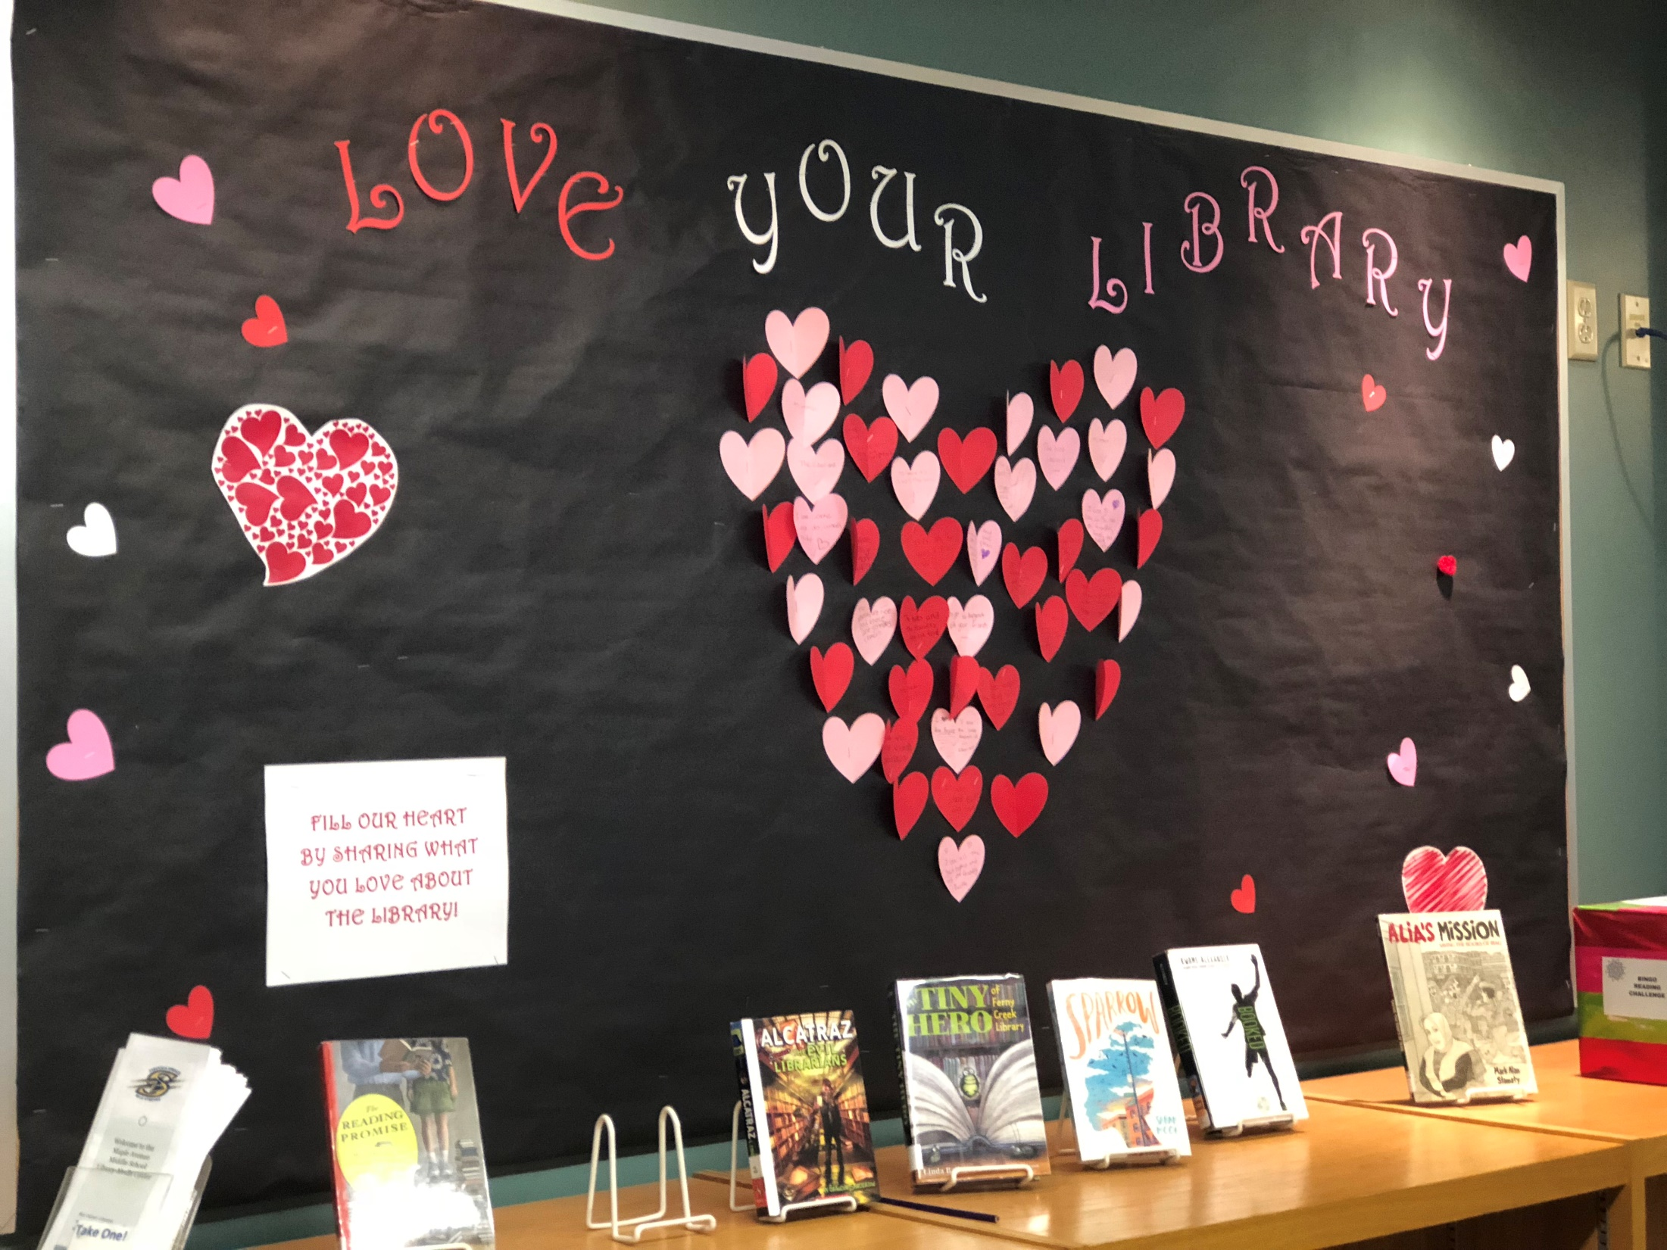

Slide 24
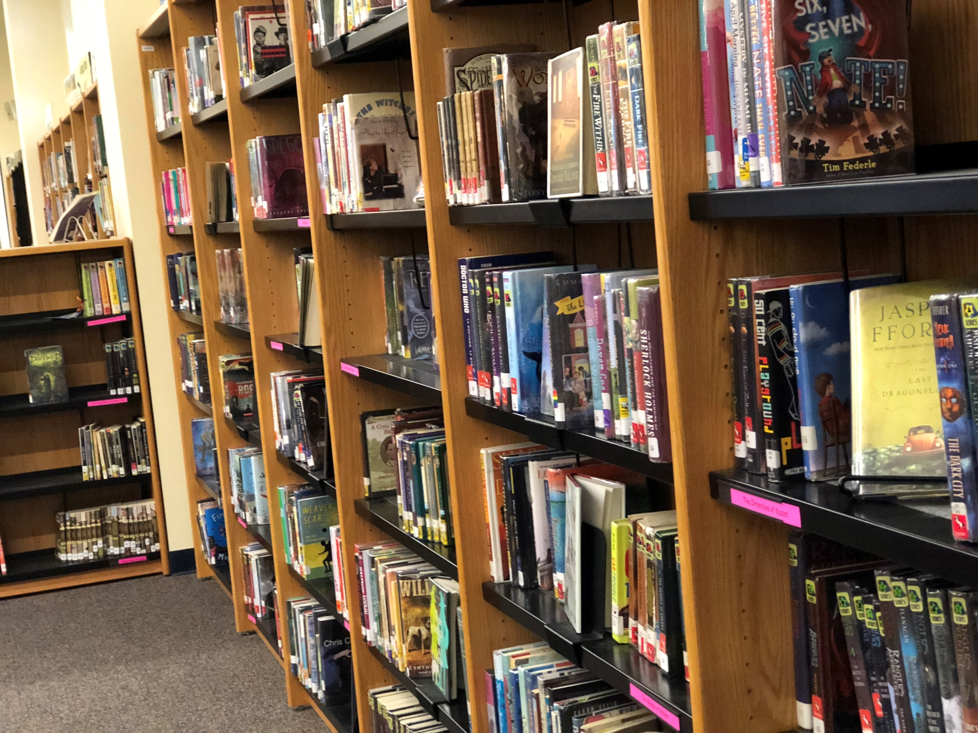

Slide 25
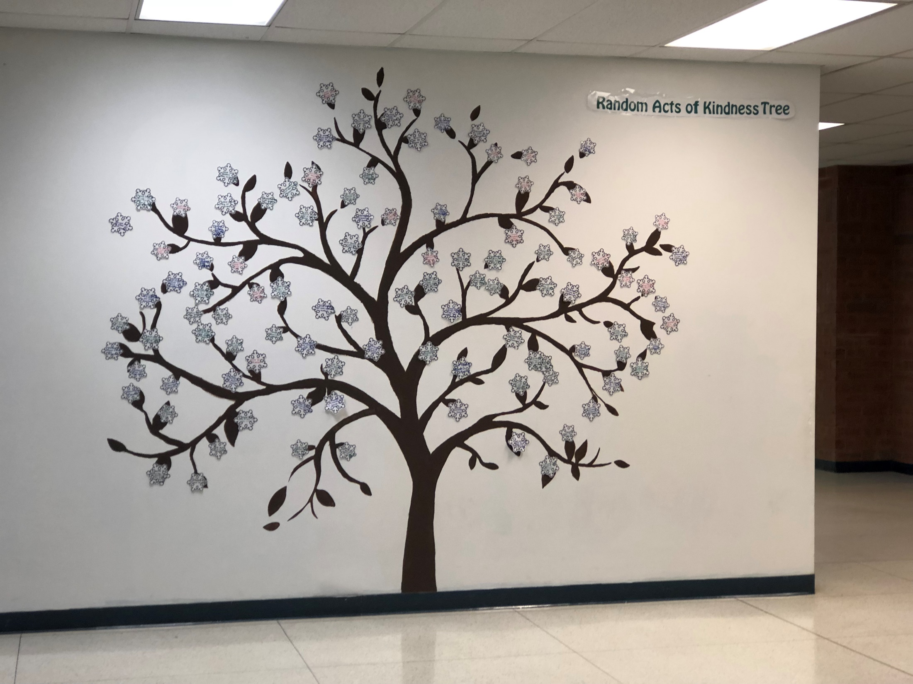

Slide 26
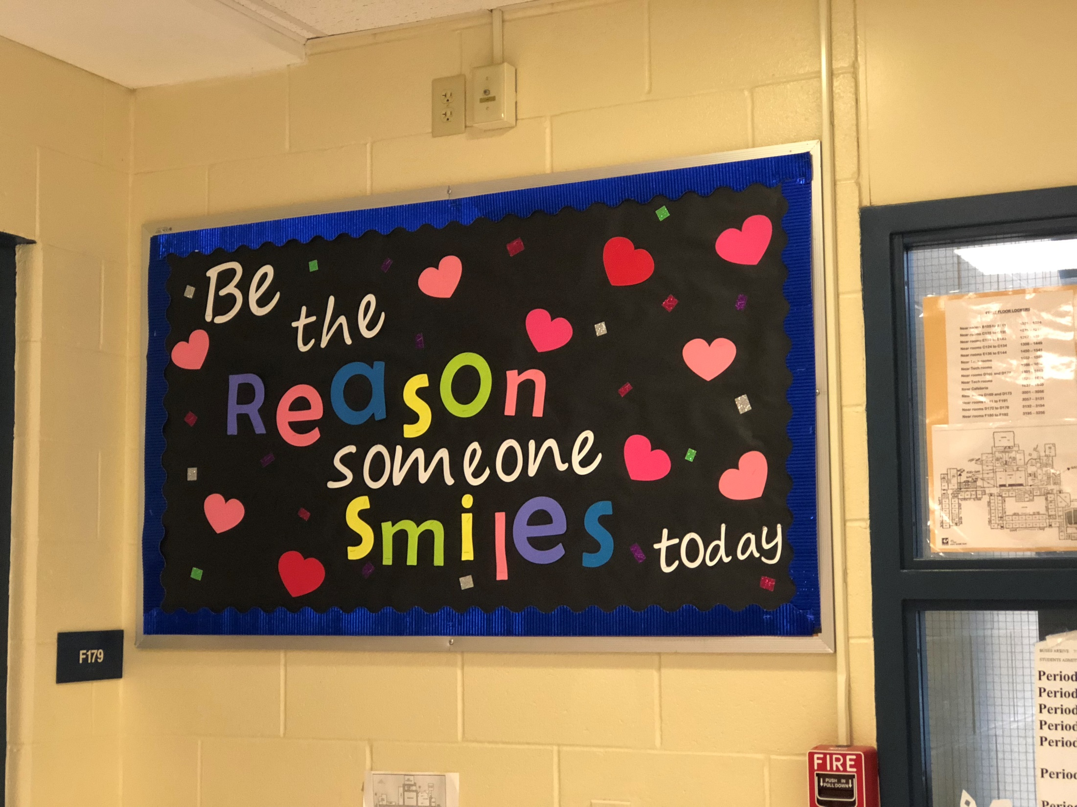

Slide 27
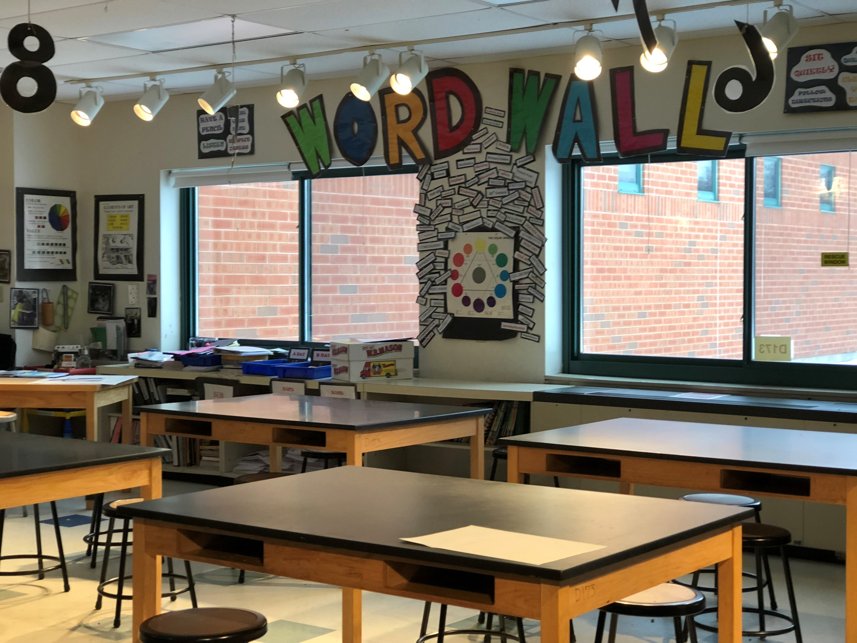

Slide 28
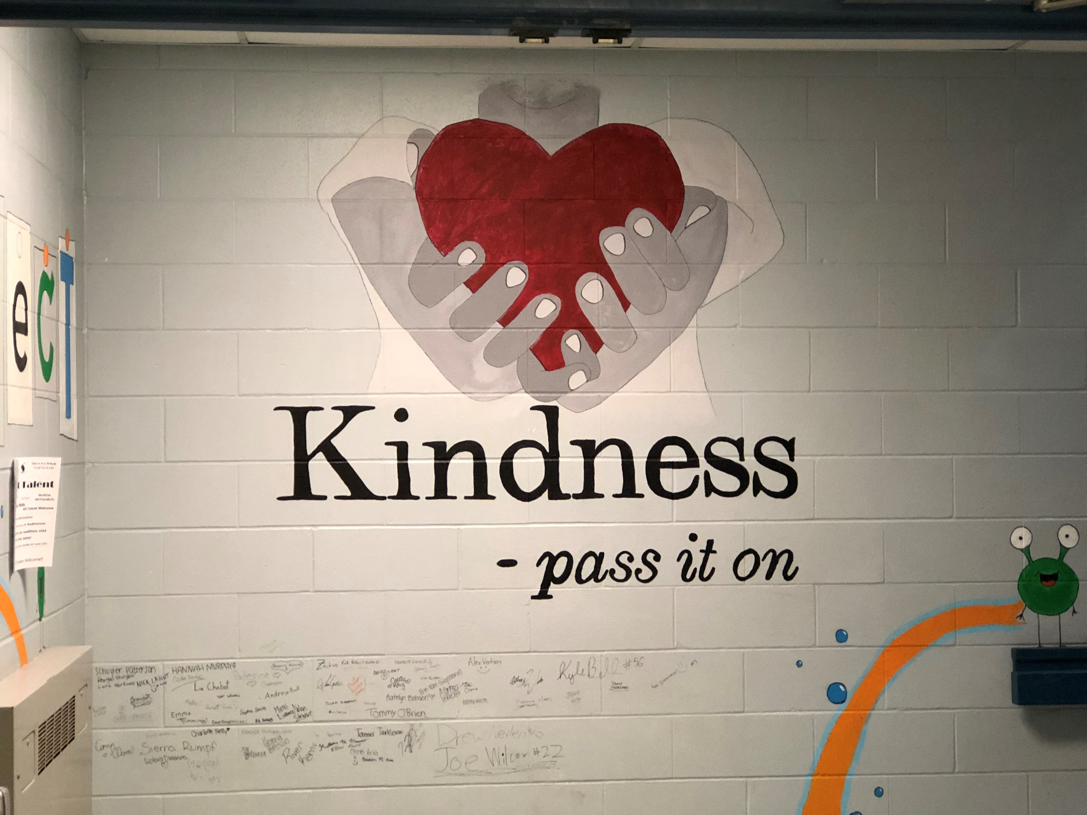

Slide 29
1. Pass out a copy of the poem to each student.
2 . Divide students into groups of about three AND assign each group a stanza number.
3. Groups should discuss the actions described in their assigned stanzas. On the lines opposite the stanza, students should describe what those actions specifically look like at Maple Avenue Middle School.

Slide 30
EXAMPLE:
STANZA 2:
It is being open and honest, responsible for all of your actions.
At Maple, being open and honest looks like students admitting they didn’t do their work, rather than making up excuses.
Being responsible means accepting a consequence without arguing. If we break a rule, like being repeatedly late to class, we should serve the consequence and get to class on time.

